Slide 1
Fundamentals of deep learning
Crash course in using PyTorch to train models
Terence Parr
MSDS program University of San Francisco

Slide 2
Supervised machine learning summary

Slide 3
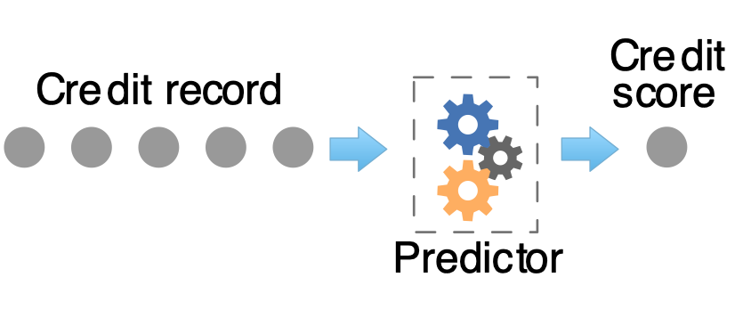
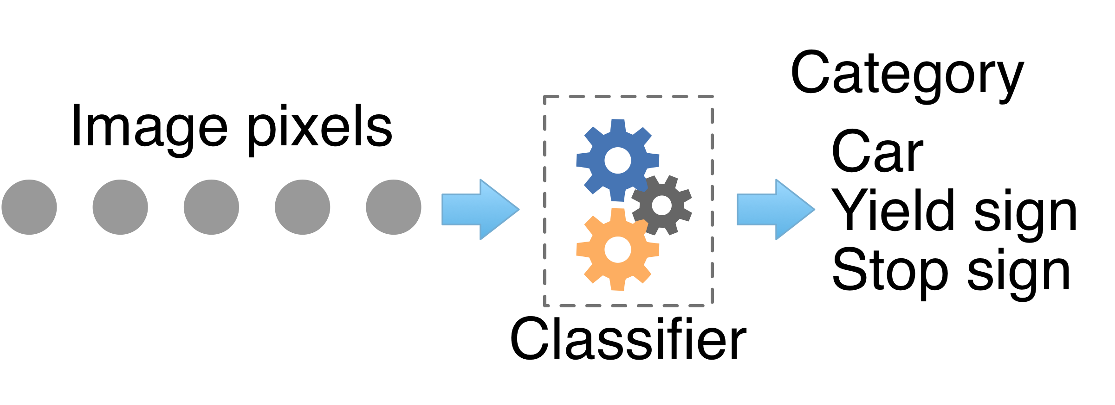
The goal of (supervised) machine learning
Obtain a model that predicts numeric values (regressor) or categories (classifier) from information about an entity:

Slide 4
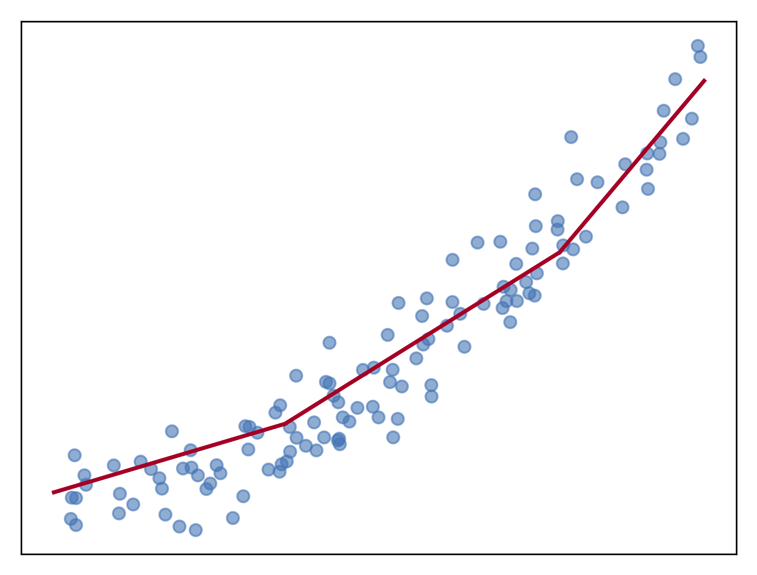
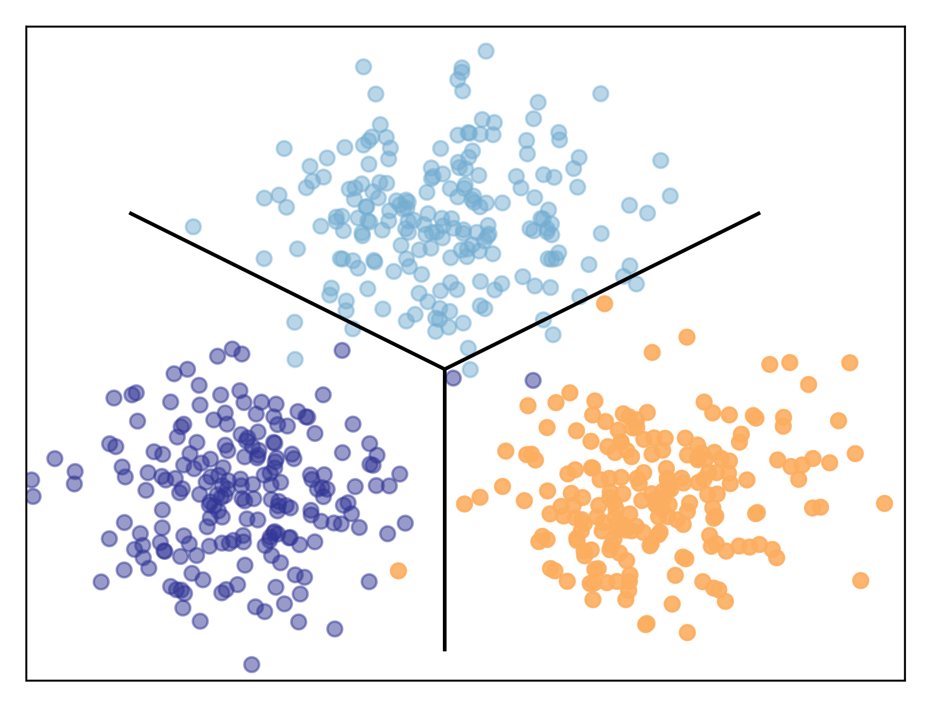
Regression versus classification
Predictors fit curves to data and classifiers draw decision boundaries between data points in different categories
Two sides of the same coin in implementation typically

Slide 5
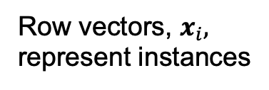
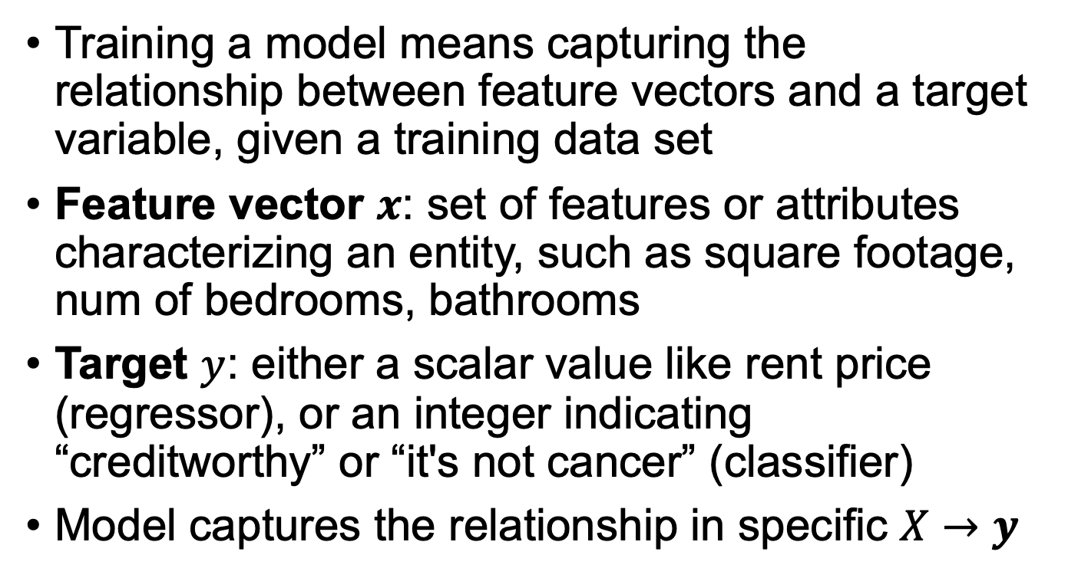
The abstraction
Training a model means capturing the relationship between feature vectors and a target variable, given a training data set
Feature vector $x$: set of features or attributes characterizing an entity, such as square footage, num of bedrooms, bathrooms
Target $y$: either a scalar value like rent price (regressor), or an integer indicating “creditworthy” or “it's not cancer” (classifier)
Model captures the relationship in specific $X→y$
Row vectors, $x_{i},$ represent instances

Slide 6
Models
Models are composed of parameters; predictions are a computation based upon these parameters
Models have architecture; e.g., number of layers, number of neurons per layer, which nonlinearity to use, etc…
Models have hyper-parameters that govern architecture and the training process; e.g., learning rate, weight decay, drop out rate
Hyper-parameters are specified by the programmer, not computed from the training data; must be tuned
Deep learning training greatly affected by learning rate, and even things like random parameter initialization

Slide 7
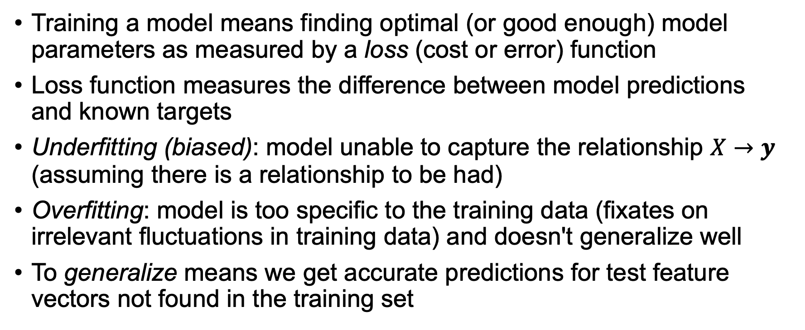
Training
Training a model means finding optimal (or good enough) model parameters as measured by a loss (cost or error) function
Loss function measures the difference between model predictions and known targets
Underfitting (biased): model unable to capture the relationship $X→y$ (assuming there is a relationship to be had)
Overfitting: model is too specific to the training data (fixates on irrelevant fluctuations in training data) and doesn't generalize well
To generalize means we get accurate predictions for test feature vectors not found in the training set

Slide 8
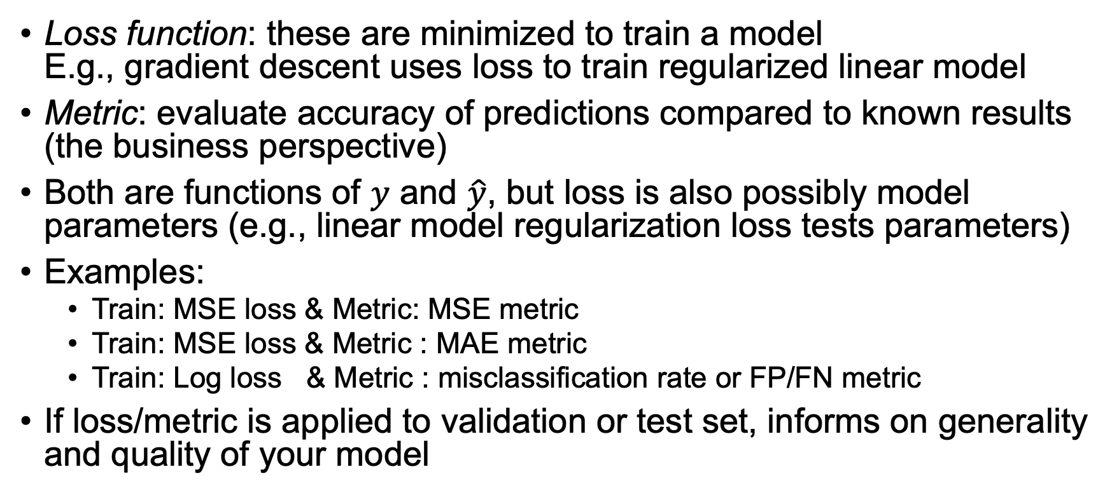
Terminology: Loss function vs metric
Loss function: these are minimized to train a model E.g., gradient descent uses loss to train regularized linear model
Metric: evaluate accuracy of predictions compared to known results (the business perspective)
Both are functions of $y$ and $\hat{y}$, but loss is also possibly model parameters (e.g., linear model regularization loss tests parameters)
Examples:
Train: MSE loss & Metric: MSE metric
Train: MSE loss & Metric : MAE metric
Train: Log loss & Metric : misclassification rate or FP/FN metric
If loss/metric is applied to validation or test set, informs on generality and quality of your model
See also stackoverflow post by Chstiros Tsatsoulis: https://goo.gl/T5AmrT

Slide 9
Train, validate, test
We always need 3 data sets with known answers:
training
validation (as shorthand you’ll hear me & others call this test set)
testing (put in a vault and don’t peek!!)
Validation set: used to evaluate, tune models and features
Any changes you make to model tailor it to this specific validation set
Test set: used exactly once after you think you have best model
The only true measure of model’s generality, how it’ll perform in production
Never use test set to tune model
Production: recombine all sets back into a big training set again, retrain model but don’t change it according to test set metrics

Slide 10
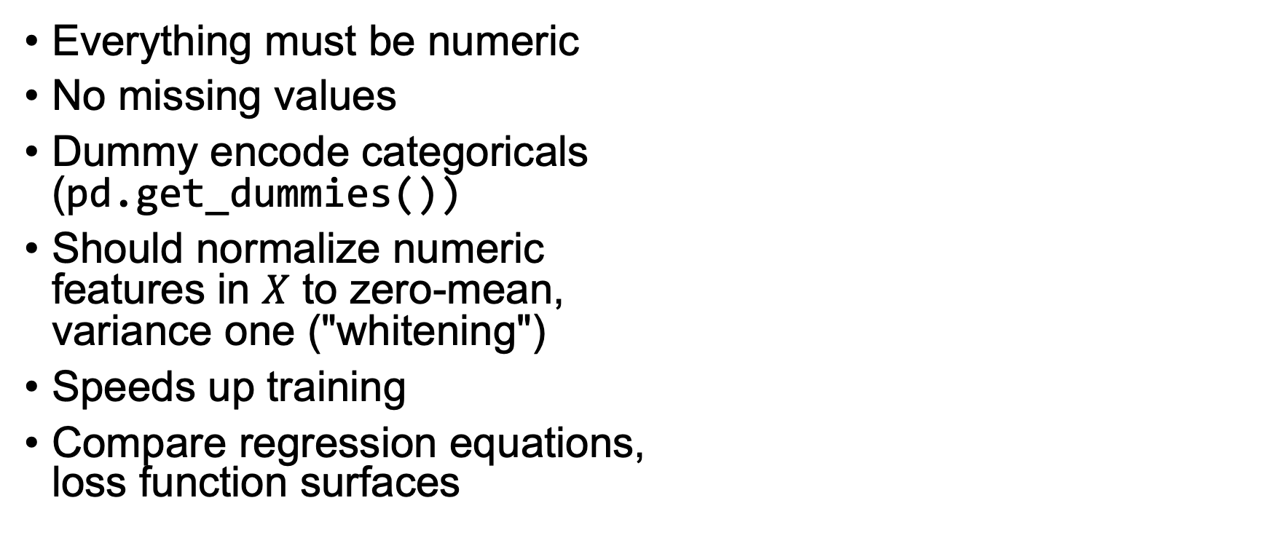
Preparing data
(Cars dataset)
Everything must be numeric
No missing values
Dummy encode categoricals (pd.get_dummies())
Should normalize numeric features in $X$ to zero-mean, variance one ("whitening")
Speeds up training
Compare regression equations, loss function surfaces

Slide 11
Deep learning regressors

Slide 12
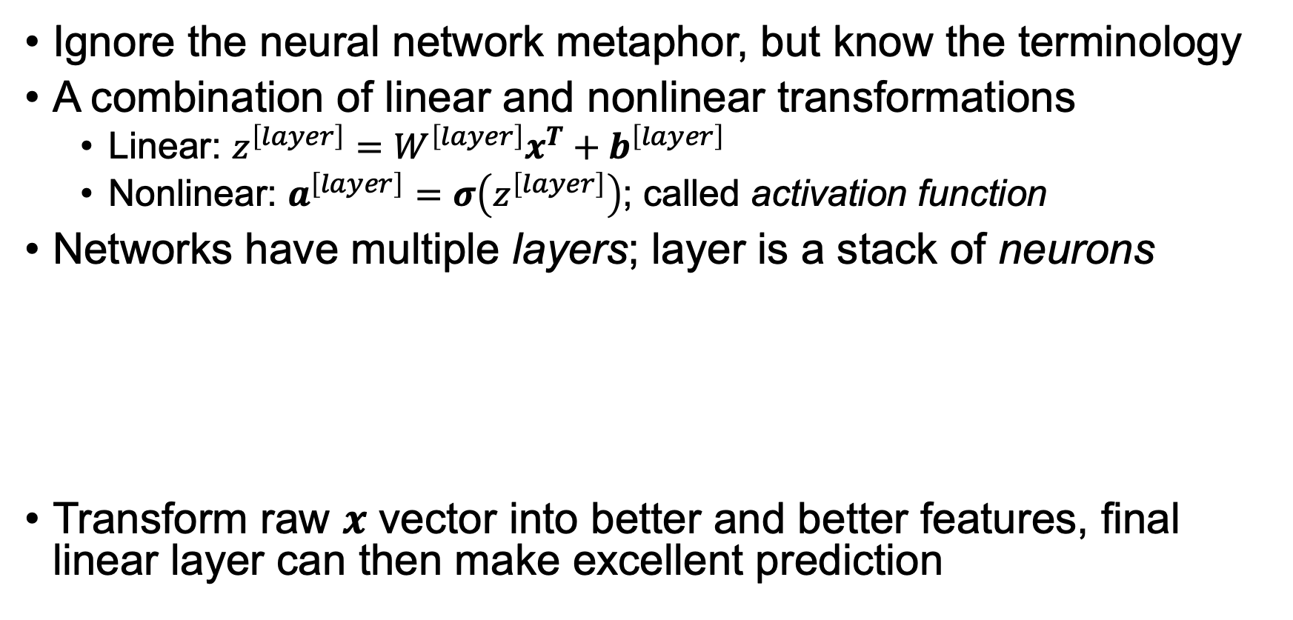
What's a neural network?
Ignore the neural network metaphor, but know the terminology
A combination of linear and nonlinear transformations
Linear: $z^{\left[layer\right]}=W^{\left[layer\right]}x^{T}+b^{\left[layer\right]}$
Nonlinear: $a^{\left[layer\right]}=σ\left(z^{\left[layer\right]}\right)$; called activation function
Networks have multiple layers; layer is a stack of neurons
Transform raw $x$ vector into better and better features, final linear layer can then make excellent prediction

Slide 13
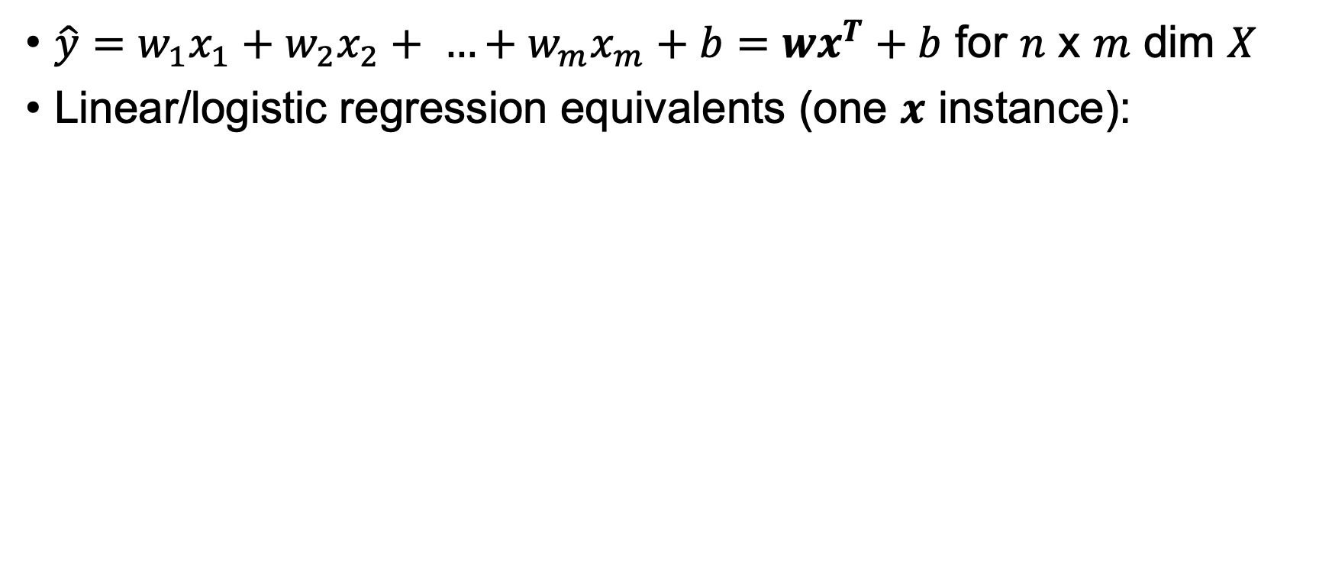
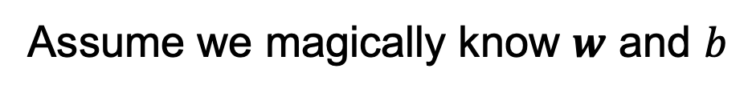
DL Building blocks
linear
sigmoid
ReLU (rectified linear unit)
$\hat{y}=w_{1}x_{1}+w_{2}x_{2}+ …+w_{m}x_{m}+b=wx^{T}+b$ for $n$ x $m$ dim $X$
Linear/logistic regression equivalents (one $x$ instance):
Regressor
Regressor
Two-class Classifier
Underfitting a bit here
(need more of a quadratic)
Assume we magically know $w$ and $b$
(For simplicity, I'm using proper $wx^{T}$ in math but omitting transpose in diagrams)

Slide 14
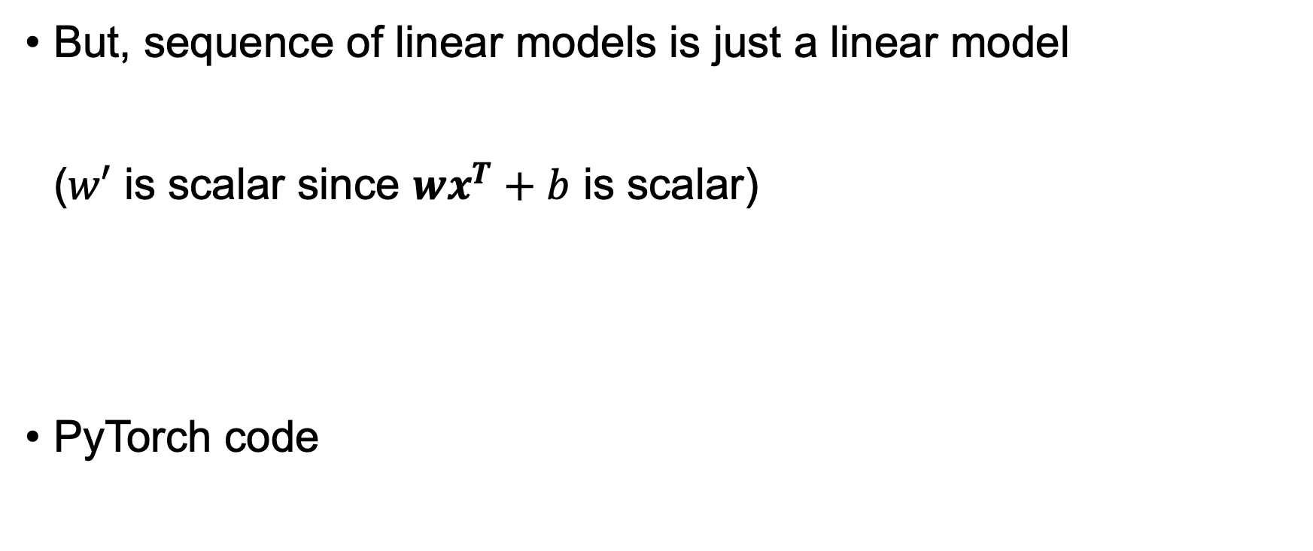
Try adding layers to get more power
But, sequence of linear models is just a linear model ($w′$ is scalar since $wx^{T}+b$ is scalar)
PyTorch code
model = nn.Sequential(
nn.Linear(m, 1), # m features
nn.Linear(1, 1)
)
Still just a line

Slide 15
Must introduce nonlinearity
model = nn.Sequential(
nn.Linear(m, 1),
nn.ReLU(),
nn.Linear(1, 1)
)
ReLU idea here: Draw two lines then clip at intersection

Slide 16
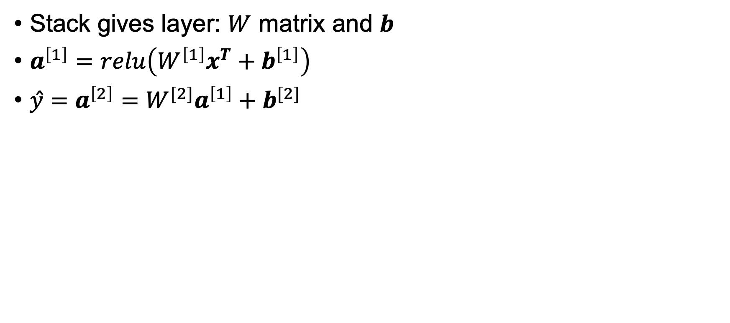
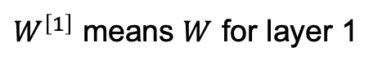
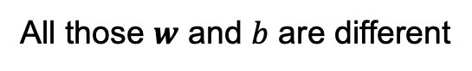
Stack linear models (neurons) for more power
Stack gives layer: $W$ matrix and $b$
$a^{\left[1\right]}=relu\left(W^{\left[1\right]}x^{T}+b^{\left[1\right]}\right)$
$ŷ={a^{\left[2\right]}=W}^{[2]}a^{\left[1\right]}+b^{[2]}$
model = nn.Sequential(
nn.Linear(m, 5),
nn.ReLU(),
nn.Linear(5, 1)
)
All those $w$ and $b$ are different
$W^{\left[1\right]}$ means $W$ for layer 1

Slide 17
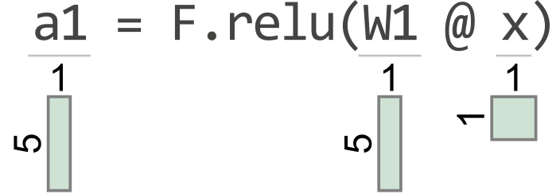
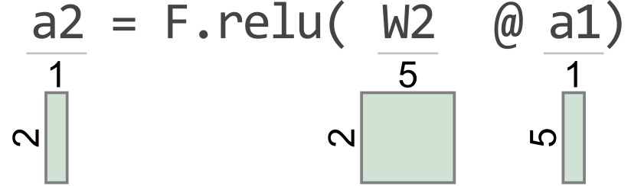
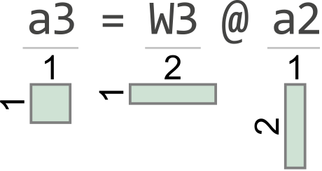
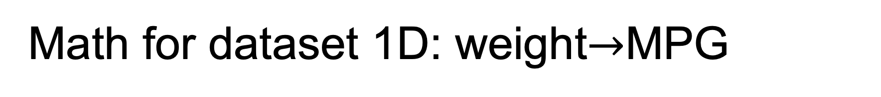
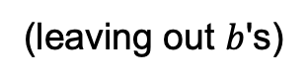
Math for dataset 1D: weight$→$MPG
(leaving out $b$'s)
model = nn.Sequential(
nn.Linear(1, 5),
nn.ReLU(),
nn.Linear(5, 2),
nn.ReLU(),
nn.Linear(2, 1)
)
(courtesy of TensorSensor)
https://explained.ai/tensor-sensor/index.html

Slide 18
Too much strength can lead to overfitting
Models with too many parameters will overfit easily, if we train a long time
We'll look at regularization later
model = nn.Sequential(
nn.Linear(1, 1000),
nn.ReLU(),
nn.Linear(1000, 1)
)

Slide 19
Classifiers

Slide 20
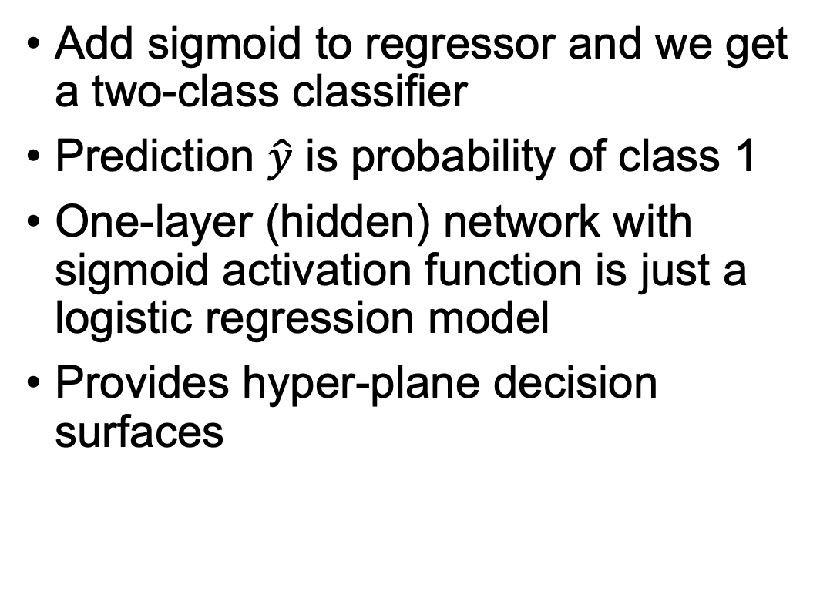
Binary classifiers
Add sigmoid to regressor and we get a two-class classifier
Prediction $\hat{y}$ is probability of class 1
One-layer (hidden) network with sigmoid activation function is just a logistic regression model
Provides hyper-plane decision surfaces
# 2 input vars: proline, alcohol model = nn.Sequential(
nn.Linear(2, 1),
nn.Sigmoid(),
)

Slide 21
Stack neurons, add layer
See https://github.com/parrt/fundamentals-of-deep-learning/blob/main/notebooks/5.binary-classifier-wine.ipynb
We get a nonlinear decision surface
model = nn.Sequential(
nn.Linear(2, 3),
nn.Sigmoid(),
nn.Linear(3, 1),
nn.Sigmoid()
)
All those $w$ and $b$ are different

Slide 22
More neurons: more complex decision surface
model = nn.Sequential(
nn.Linear(2, 10),
nn.Sigmoid(),
nn.Linear(10, 1),
nn.Sigmoid()
)
Likely overfit
Not only more complex than hyperplane but non-contiguous regions!

Slide 23
Even ReLUs can get "curvy" surfaces
model = nn.Sequential(
nn.Linear(2, 10),
nn.ReLU(),
nn.Linear(10, 10),
nn.ReLU(),
nn.Linear(10, 1),
nn.Sigmoid()
)
(Last activation function still must be sigmoid)

Slide 24
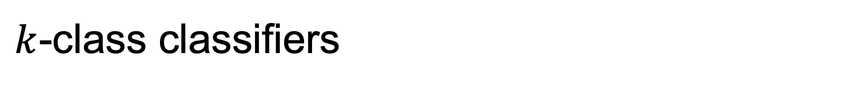
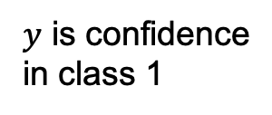
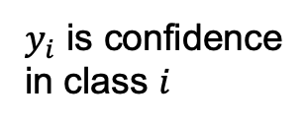
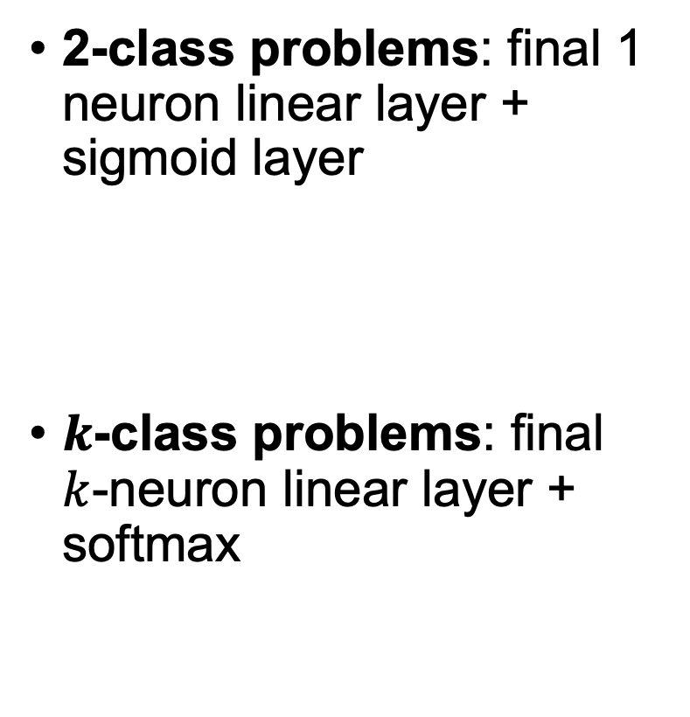
$k$-class classifiers
$y$ is confidence
in class 1
2-class problems: final 1 neuron linear layer + sigmoid layer
$k$-class problems: final $k$-neuron linear layer + softmax
$y_{i}$ is confidence
in class $i$

Slide 25
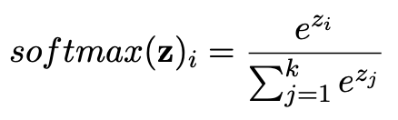
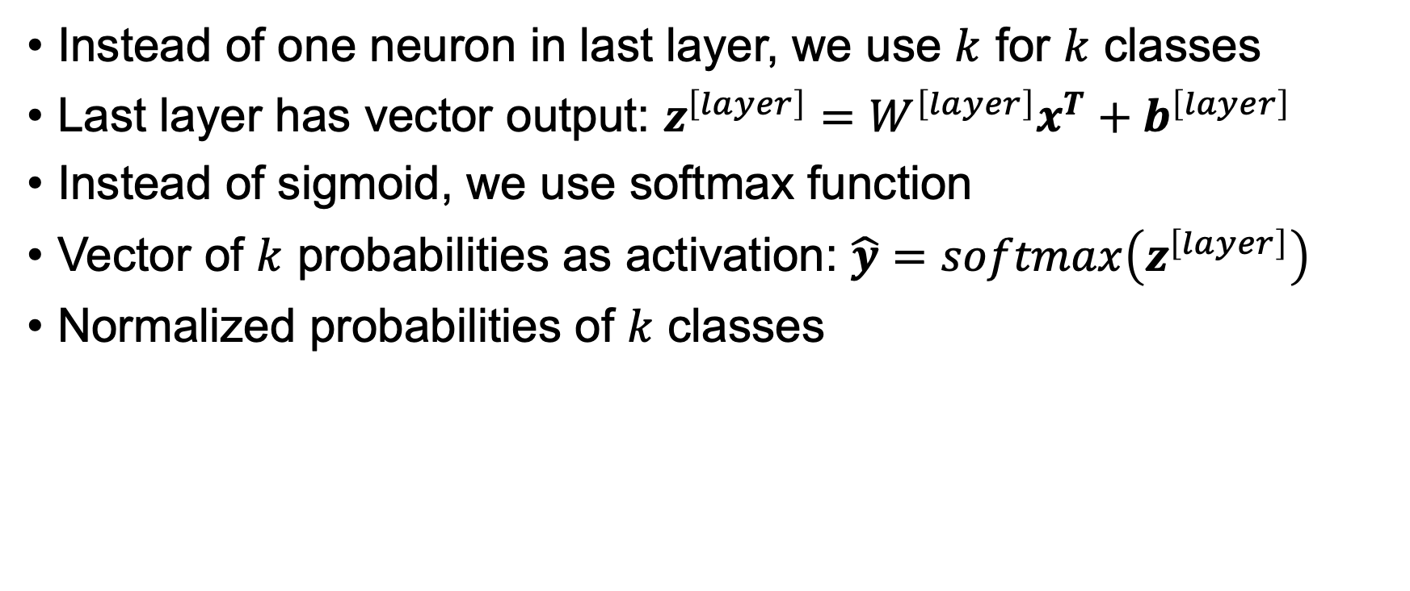
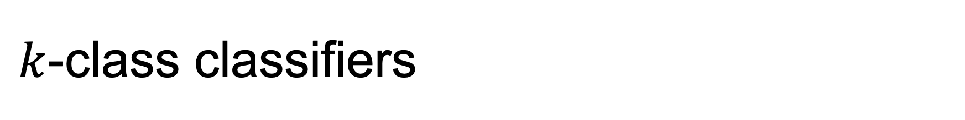
$k$-class classifiers
Instead of one neuron in last layer, we use $k$ for $k$ classes
Last layer has vector output: $z^{\left[layer\right]}=W^{\left[layer\right]}x^{T}+b^{\left[layer\right]}$
Instead of sigmoid, we use softmax function
Vector of $k$ probabilities as activation: $\hat{y}=softmax\left(z^{\left[layer\right]}\right)$
Normalized probabilities of $k$ classes

Slide 26
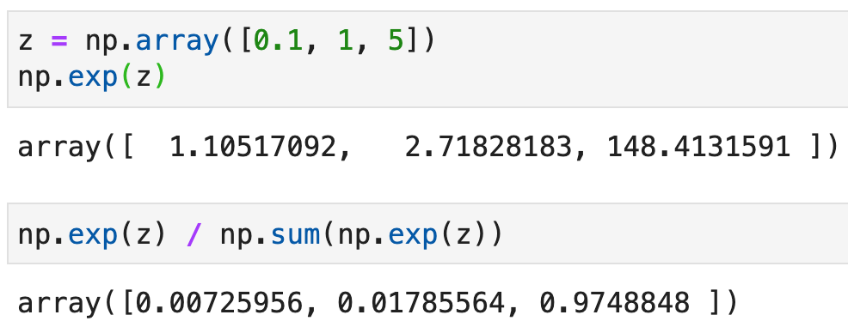
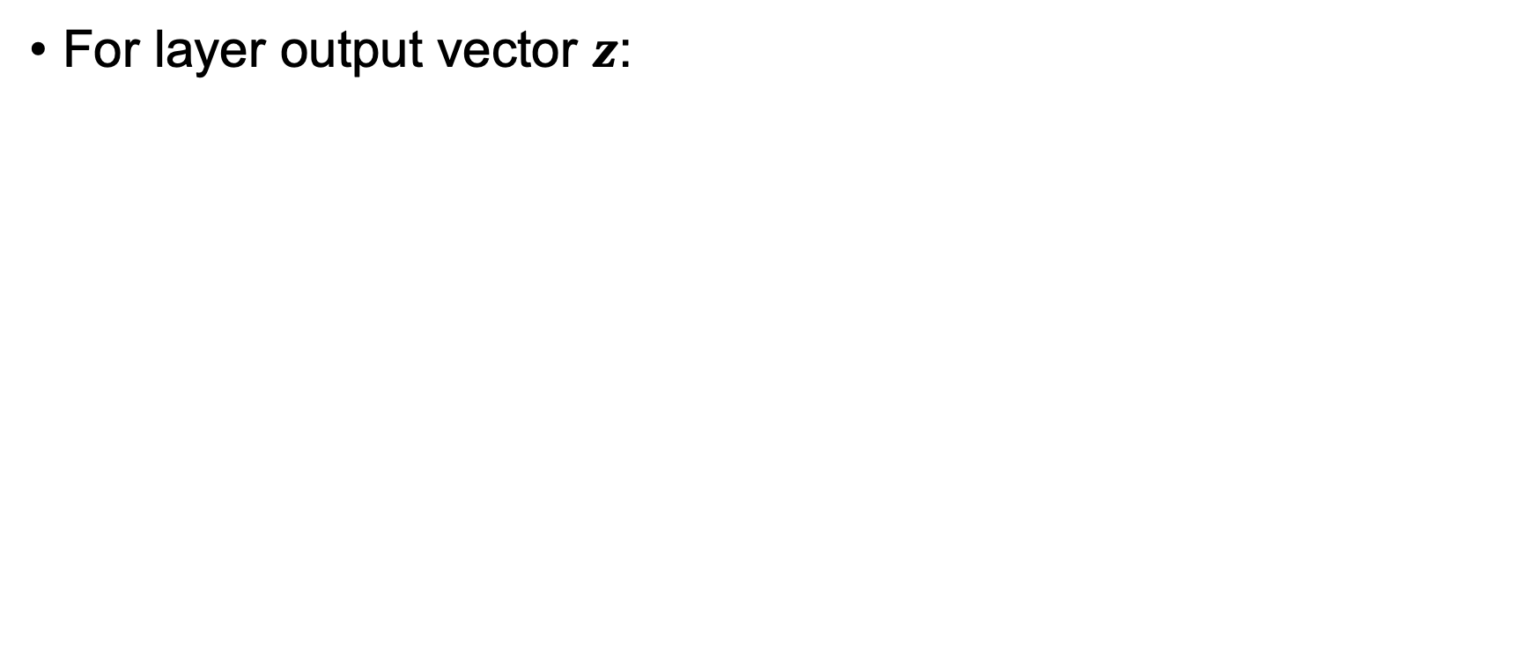
Sample softmax computation
For layer output vector $z$:

Slide 27
Training deep learning networks

Slide 28
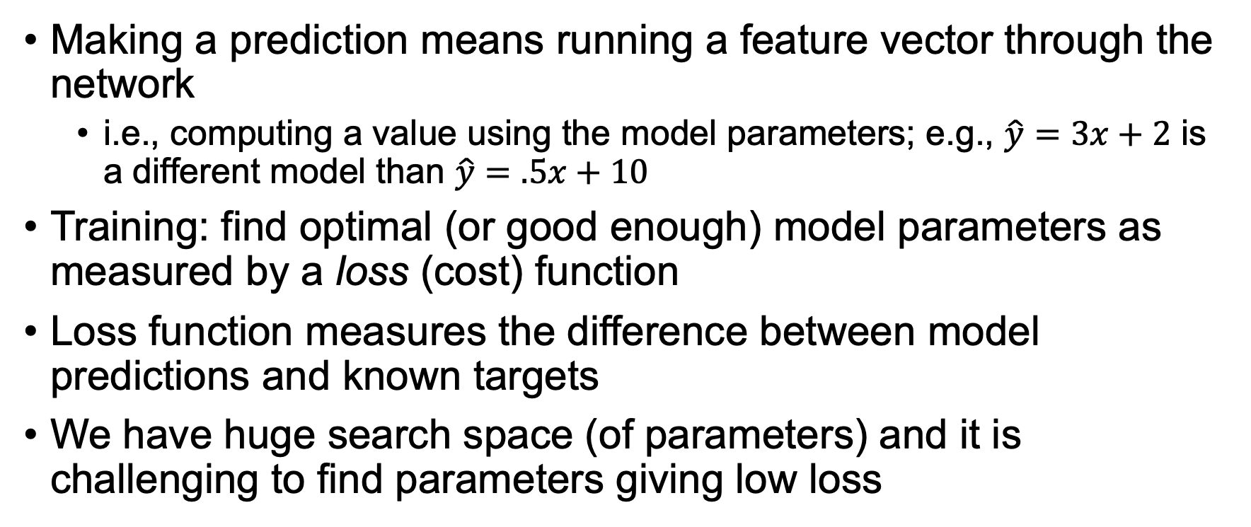
What does training mean?
Making a prediction means running a feature vector through the network
i.e., computing a value using the model parameters; e.g., $\hat{y}=3x+2$ is a different model than $\hat{y}=.5x+10$
Training: find optimal (or good enough) model parameters as measured by a loss (cost) function
Loss function measures the difference between model predictions and known targets
We have huge search space (of parameters) and it is challenging to find parameters giving low loss

Slide 29
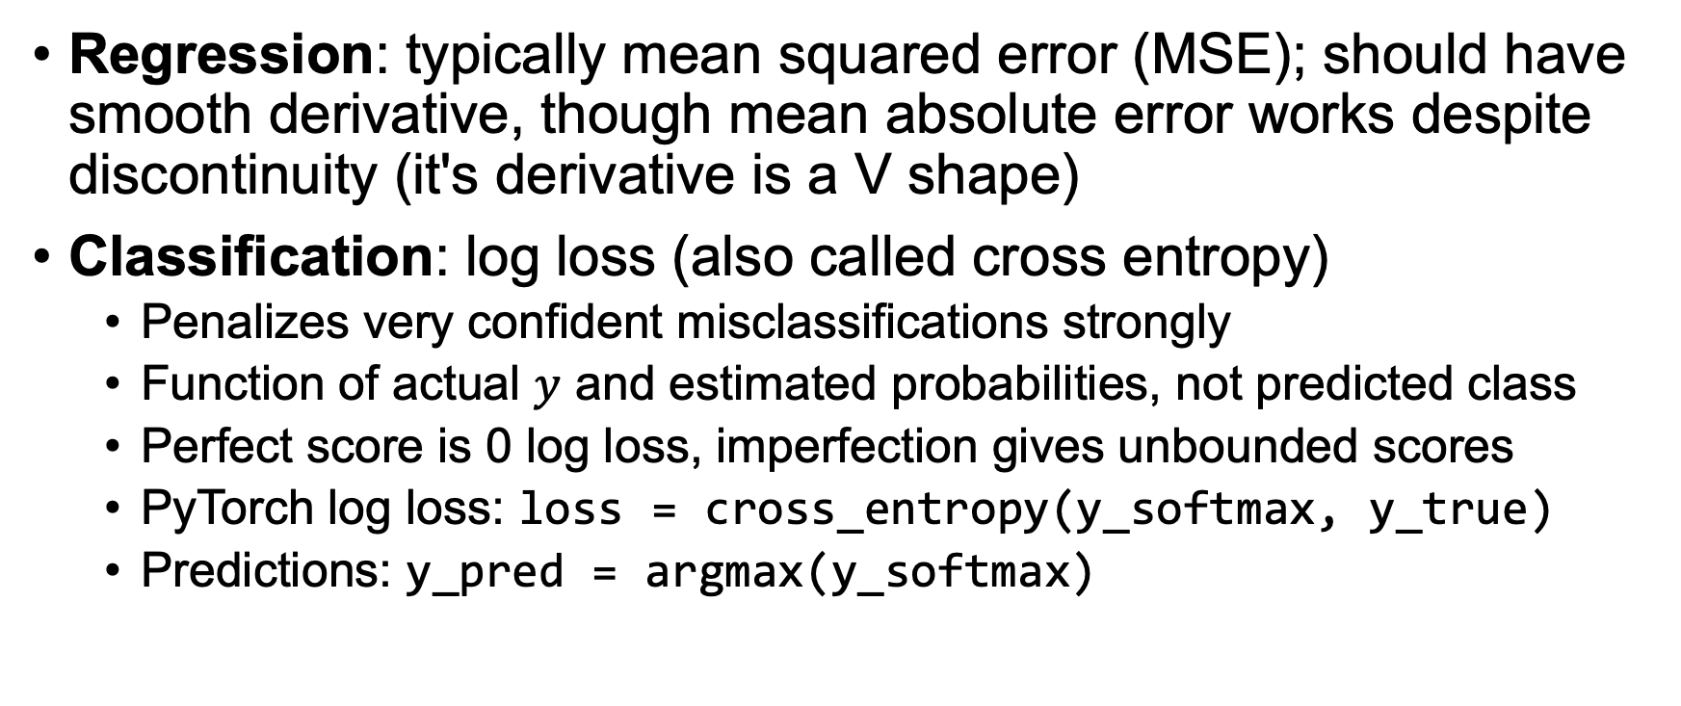
Loss functions
Regression: typically mean squared error (MSE); should have smooth derivative, though mean absolute error works despite discontinuity (it's derivative is a V shape)
Classification: log loss (also called cross entropy)
Penalizes very confident misclassifications strongly
Function of actual $y$ and estimated probabilities, not predicted class
Perfect score is 0 log loss, imperfection gives unbounded scores
PyTorch log loss: loss = cross_entropy(y_softmax, y_true)
Predictions: y_pred = argmax(y_softmax)

Slide 30
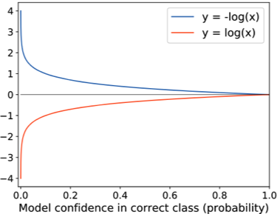
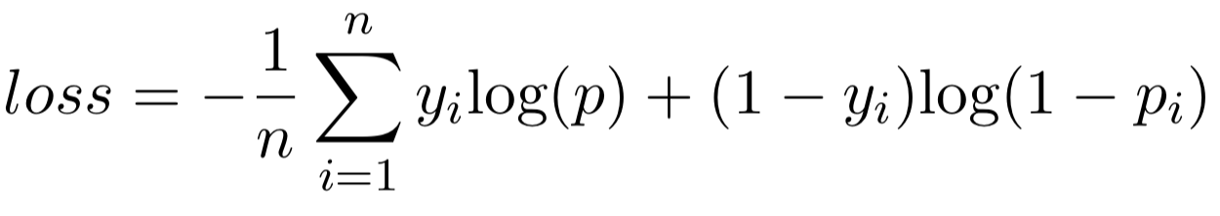
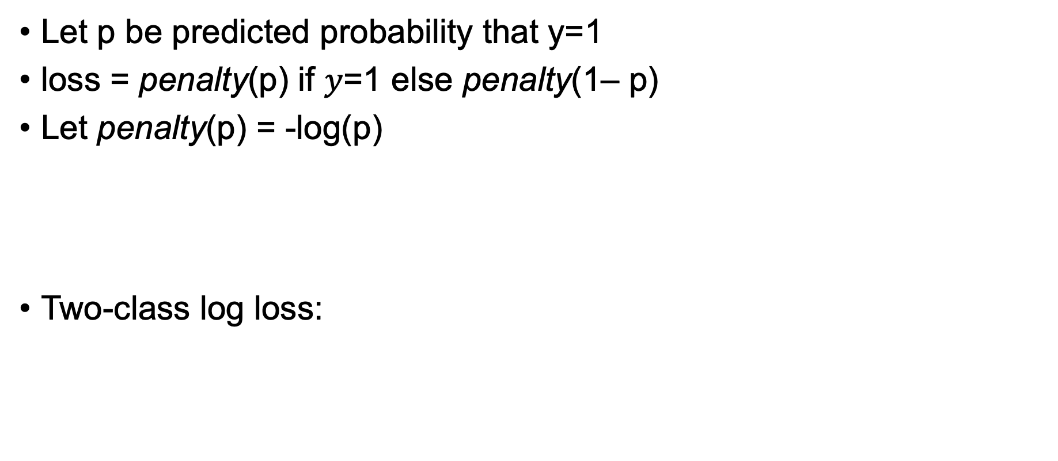
Log loss
penalty(p)
Let p be predicted probability that y=1
loss = penalty(p) if $y$=1 else penalty(1– p)
Let penalty(p) = -log(p)
Two-class log loss:
So log loss is average penalty where penalty is very high
for confidence in wrong answer

Slide 31
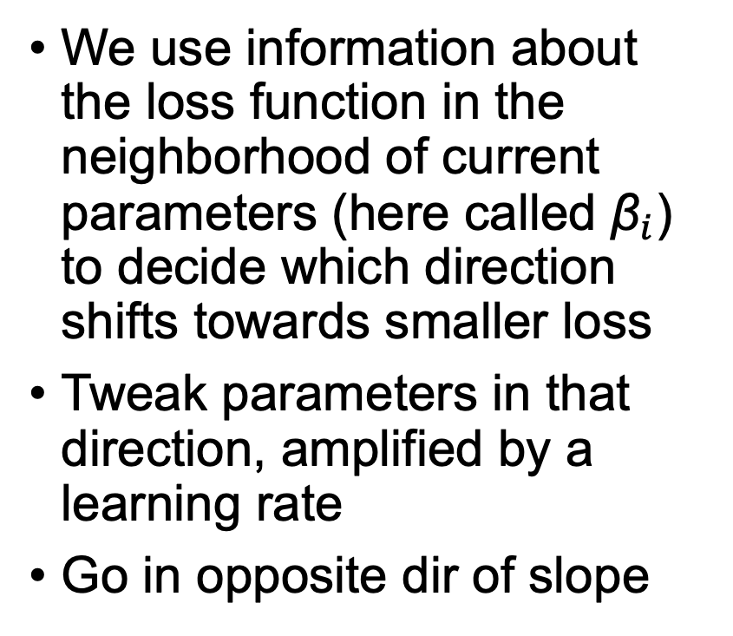
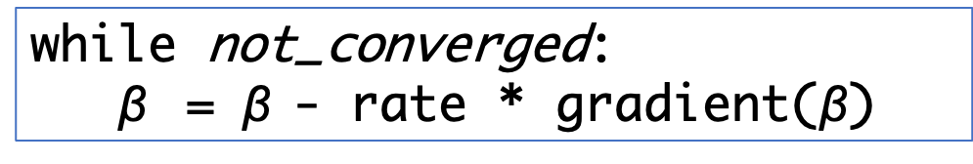
Minimize loss with Gradient descent
while not_converged:
$\text{β}$ = $\text{β}$- rate * gradient($\text{β}$)
We use information about the loss function in the neighborhood of current parameters (here called ${\text{β}}_{i}$) to decide which direction shifts towards smaller loss
Tweak parameters in that direction, amplified by a learning rate
Go in opposite dir of slope

Slide 32
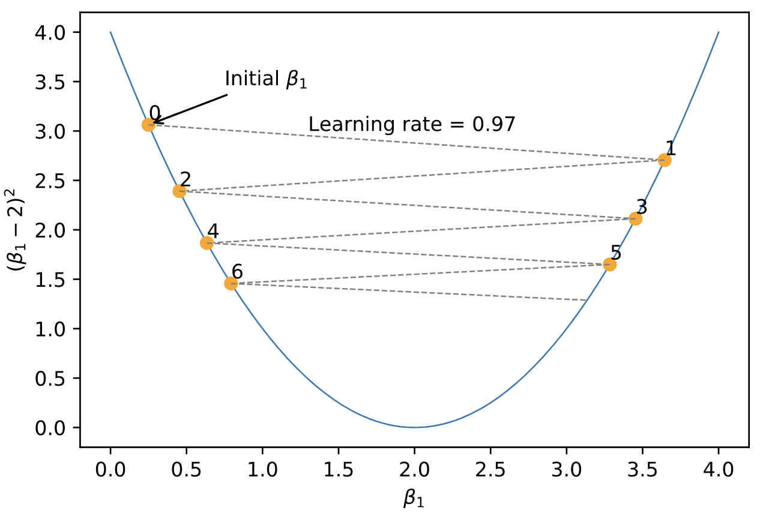
If learning rate is too high?
We oscillate across valleys
It can even diverge, exploding
If too small, we don’t make progress to min

Slide 33
Training process
Prepare data
normalize numeric variables
dummy vars for categoricals
conjure up values for missing values
Split out at least a validation set from training set
Choose network architecture, appropriate loss function
Choose hyper-parameters, such as dropout rate
Choose a learning rate, number of epochs (passes through data)
Run training loop (until validation error goes up or num iterations)
Goto 3, 4, or 5 to tweak; iterate until good enough

Slide 34
Training loop
Regression
Vectorized forward network pass
(send in all instances at once)
for epoch in range(nepochs):
y_train_pred = model(X_train)
loss = MSE(y_train_pred, y_train)
update model parameters in direction of lower loss
Classification
for epoch in range(nepochs):
y_train_pred = model(X_train) # assume softmax final layer
loss = cross_entropy(y_train_pred, y_train)
update model parameters in direction of lower loss

Slide 35
Common train vs validation loss behavior
DL networks have so many parameters, we can often get training error down to zero!
But, we care about generalization
Unfortunately, validation error often tracks away from training error as the number of epochs increases
This model is clearly overfitting
Need to use regularization to improve validation loss

Slide 36
Regularization techniques
Get more training data; can try augmentation techniques (more data is likely to represent population distribution better)
Reduce number of model parameters (i.e., simplify it) (reduce power/ability to fit the noise)
Add drop out layers (randomly kill some neurons)
Weight decay (L2 regularization on model parameters, restrict model parameter search space)
Early stopping, when validation error starts to go up (generally we choose model that yields the best validation error)
Batch normalization has some small regularization effect (Force layer activation distributions to be 0-mean, variance 1)
Stochastic gradient descent tends to land on better generalizations

Slide 37
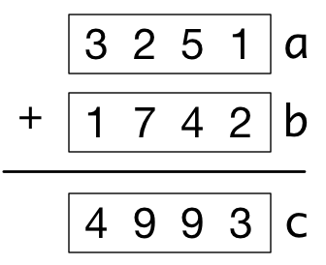
Aside: What is vectorization?
Use vectors not loops
For torch/numpy arrays, we can use vector math instead of a loop: c = a + b
Gives an opportunity to execute vector addition in parallel
for i in range(len(a)):
c[i] = a[i] + b[i]

Slide 38
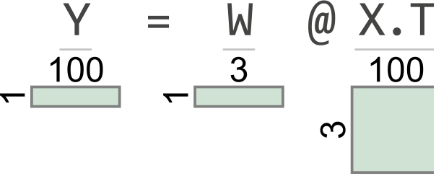
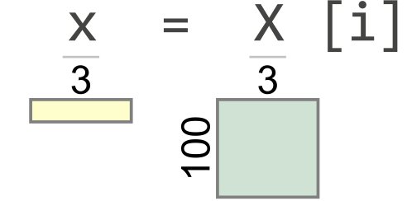
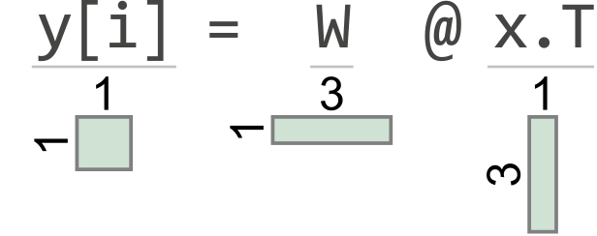
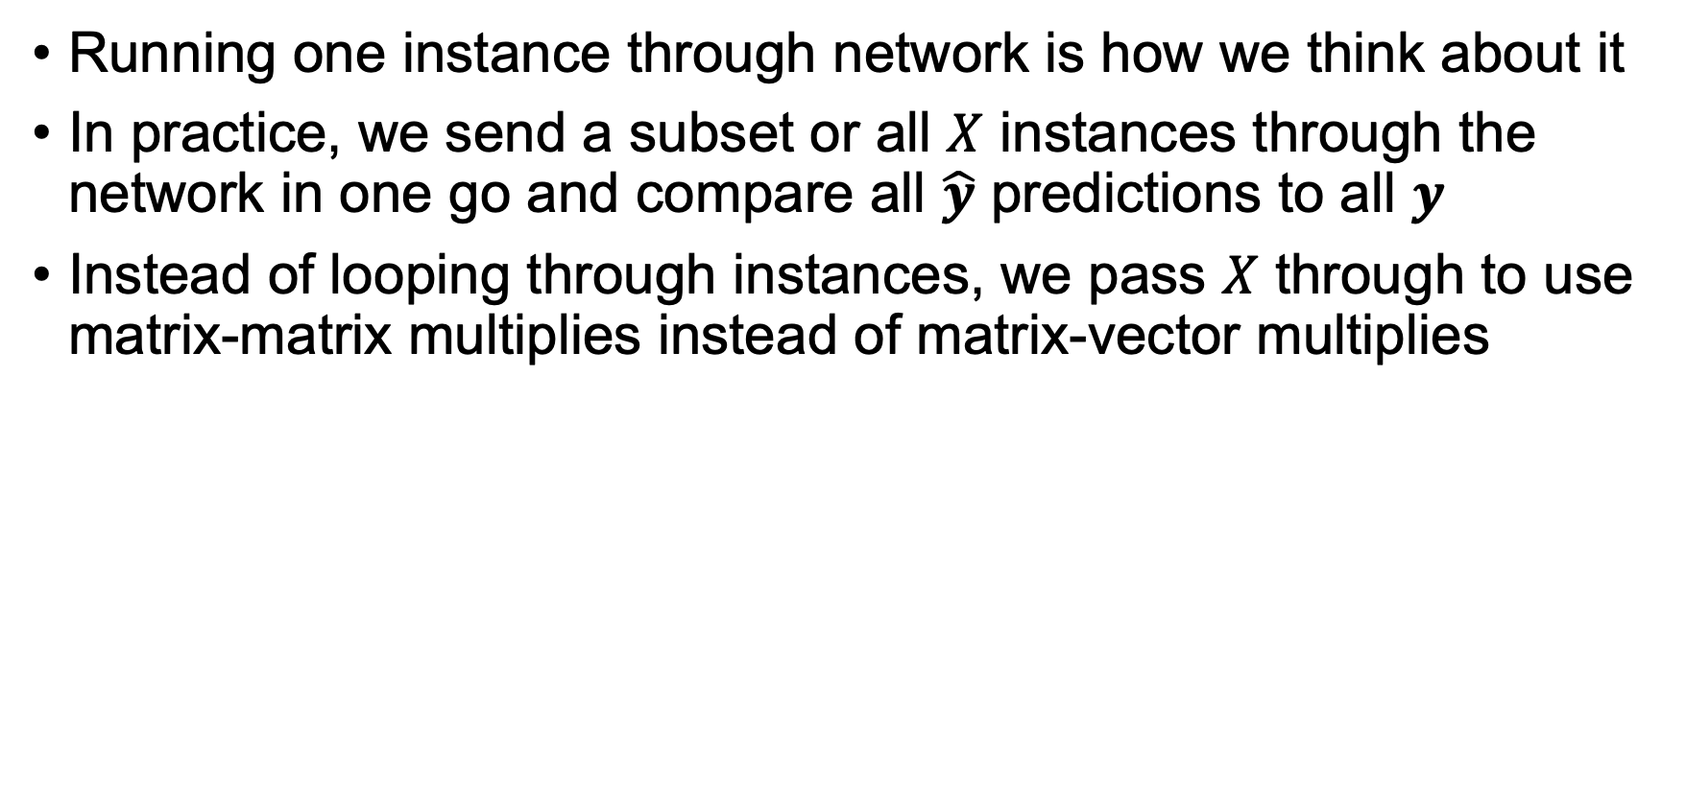
Vectorization in training loop
Running one instance through network is how we think about it
In practice, we send a subset or all $X$ instances through the network in one go and compare all $\hat{y}$ predictions to all $y$
Instead of looping through instances, we pass $X$ through to use matrix-matrix multiplies instead of matrix-vector multiplies
for epoch in range(nepochs):
for i in range(n):
x = X[i]
y[i] = model(x)
…
for epoch in range(nepochs):
Y = model(X)
…
Get 100
answers
Assume n=100, m=3, n_neurons=1 in 1x3 weight matrix W

Slide 39
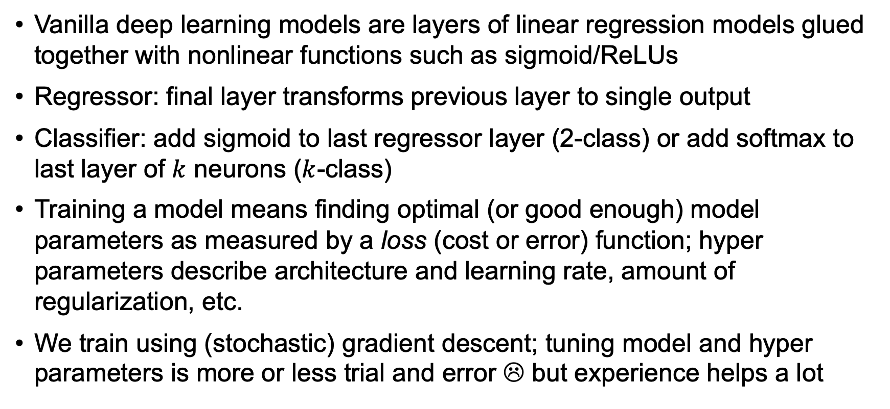
Summary
Vanilla deep learning models are layers of linear regression models glued together with nonlinear functions such as sigmoid/ReLUs
Regressor: final layer transforms previous layer to single output
Classifier: add sigmoid to last regressor layer (2-class) or add softmax to last layer of $k$ neurons ($k$-class)
Training a model means finding optimal (or good enough) model parameters as measured by a loss (cost or error) function; hyper parameters describe architecture and learning rate, amount of regularization, etc.
We train using (stochastic) gradient descent; tuning model and hyper parameters is more or less trial and error ☹ but experience helps a lot

